Slide 1
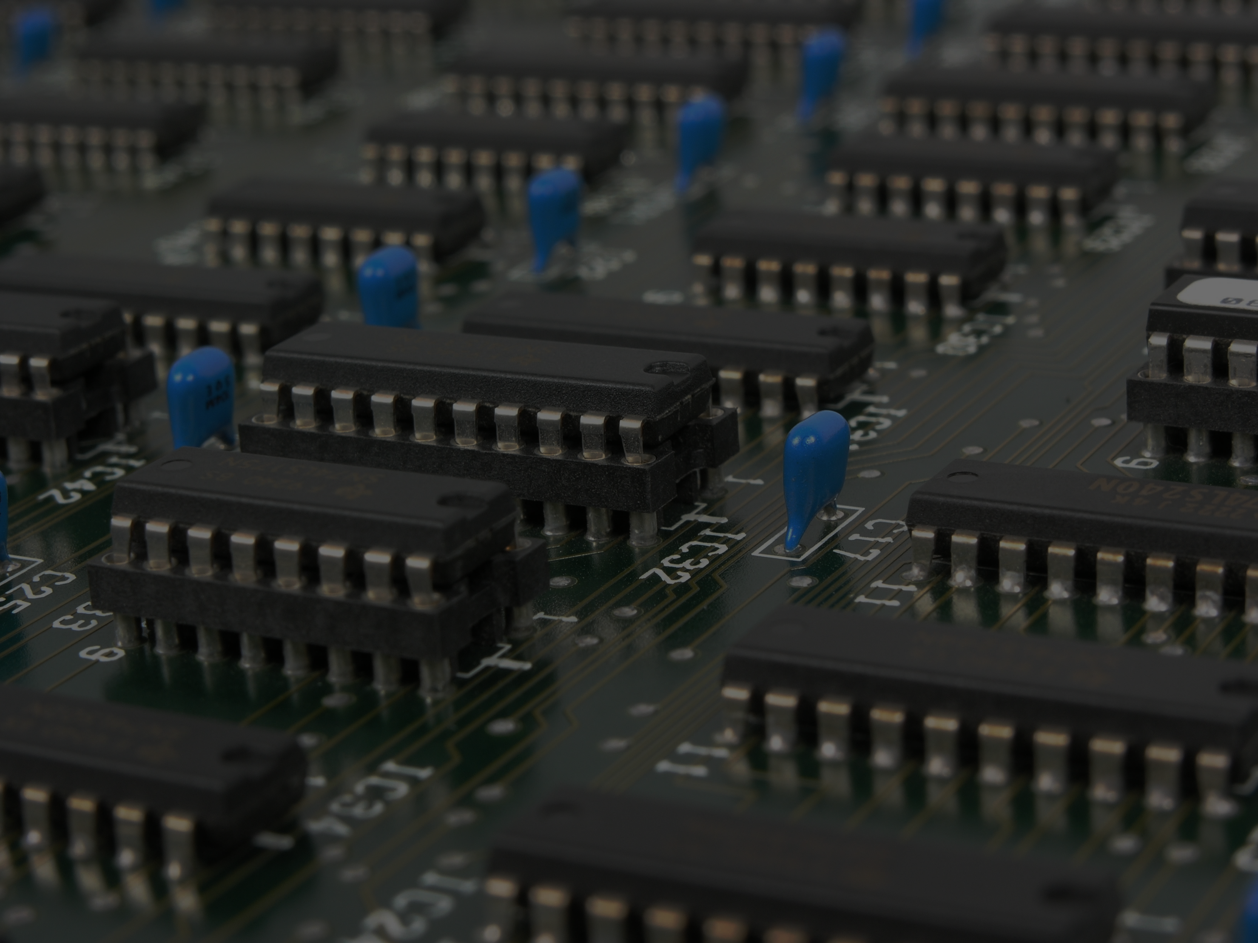
High-Performance Computing (HPC) and Scaling in Azure
[ Instructor Name ]
[ Instructor E-mail ]

Slide 2
Agenda
High-Performance Computing and Scaling Up versus Scaling Out
Simple Linux Utility for Resource Management (SLURM)

Slide 3
High-Performance Computing

Slide 4
High-Performance Computing (HPC)
“High-Performance Computing most generally refers to the practice of aggregating computing power in a way that delivers much higher performance than one could get out of a typical desktop computer or workstation in order to solve large problems in science, engineering, or business.”
--Inside HPC
Notes:
High performance computing (HPC) typically refers to computing power beyond that of a typical desktop computer. Obviously, the definition of high performance changes with time as more computing power is crammed into smaller spaces, making supercomputers of today commodity computers of tomorrow. Regardless though, the concepts of HPC have remained the same since the early days of computing wherein scientists and engineers worked to figure out how aggregate more computing resources to perform computing tasks.

Slide 5
HPC Clusters
HPC typically involves clusters of computers interconnected by a high speed network
A single computer in the cluster is called a node
Workloads are managed by master nodes that distribute workloads across worker nodes
Notes:
High Performances Computing is typically performed on a cluster for computers interconnected by a high speed network. Workloads are sent to a master node which delegates tasks to the worker nodes on the cluster to perform. Historically, clusters were built using proprietary, often purpose built computers. Recent trends though have shifted to using commodity hardware – the same kind of components used to build desktop computers – to construct HPC clusters. Engineers are getting even more clever with how they build cluster too. The latest trend in HPC has been to use GPU’s in addition to CPU’s to created HPC’s. While a typical desktop CPU has 2, 4, or 8 cores, Ggraphics cards have usually hundreds of cores. These cores, while not as powerful as CPU cores, can still perform computations. HPC Clusters are combining CPU’s and GPU’s to squeeze even more performance out of computer hardware for heavy workloads.

Slide 6
Vertical Scaling
Vertical Scaling or “Scaling Up” means aggregating more computing resources into a single node
Notes:
Vertical scaling simply means adding more computer resources to a single node on a cluster. This is not much different than the conventional idea of a computer upgrade in where one adds more RAM or a faster CPU with more cores to a laptop or desktop. In HPC, upgrading the CPU count and RAM in the nodes in a cluster is vertical scaling.

Slide 7
Horizontal Scaling
Horizontal Scaling or "Scaling Out" means adding more nodes to a cluster
Notes:
Horizontal Scaling is simply adding more nodes to a cluster. Worker nodes on a cluster typically outnumber the master nodes because the worker nodes are the ones performing the computations in an HPC workload. Adding more nodes to a cluster gives more computing resources to perform more work.

Slide 8
Scaling
The combined effect of Horizontal and Vertical Scaling increases computing performance for HPC workloads
Notes:
Horizontal Scaling and Vertical Scaling can both increase performance on an HPC cluster. How these impact a particular workload though depends on the workload. Each node on an HPC cluster is an autonomous computer with its own operating system, RAM, CPU, and so on. The operating system on the node manages the resources on the node. A workload that can take advantage of multiple CPU’s on a node may benefit greatly from vertical scaling, however a workload that does not do take advantage of multiple CPU’s on a node (typically, a single-threaded application) will not benefit greatly from vertical scaling, but more so from horizontal scaling. Most HPC clusters do both horizontal and vertical scaling though.

Slide 9
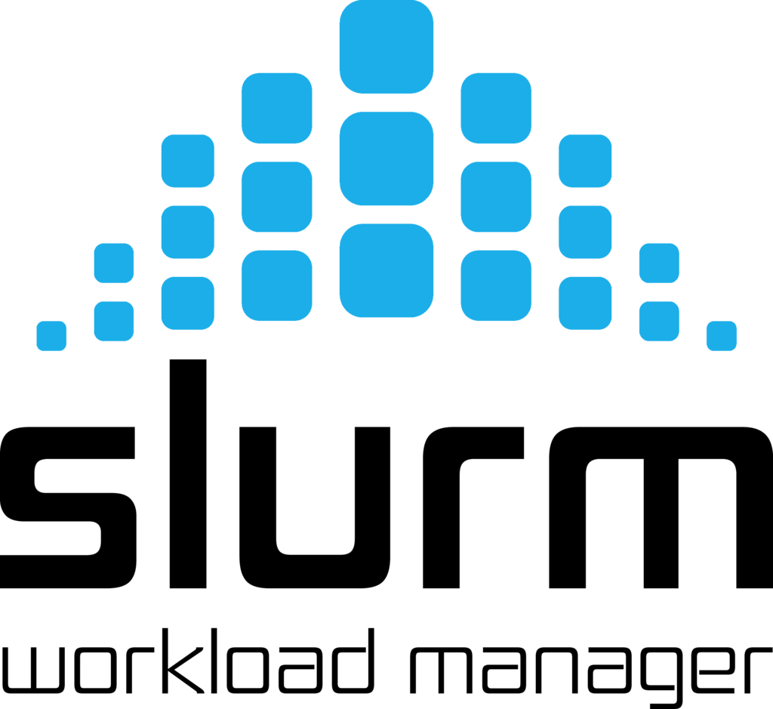

Slide 10
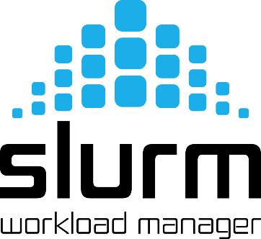
SLURM
SLURM Workload Manager used to be known by the acronym Simple Linux Utility for Resource Management
SLURM is an open-source project designed to manage workloads on Linux HPC clusters
Most of the world’s fastest supercomputers use SLURM to manage workloads
SLURM is fault tolerant, dynamically scalable, and highly configurable based on the workloads
https://slurm.schedmd.com/
Notes:
Slurm, while not the only workload manager available, is the most popular among HPC applications. It has been ported to all sorts of HPC applications and infrastructures, and even allows for unlike operating systems and hardware to run as part of the same HPC clusters. Likewise, Slurm is fault tolerant and highly scalable. Over 60% of the TOP500 Supercomputers, a list of the worlds fastest computers, use Slurm to manage workloads.

Slide 11

SLURM on Azure
Microsoft Azure offers a deployment template that builds SLURM HPC clusters in the cloud
Azure-based SLURM clusters are ad-hoc, meaning they can be created, used, and destroyed as needed. One simply pays for the resource utilization without the need to buy, build, and configure hardware clusters, which is both time-consuming and expensive
+
Notes:
The availability of cloud-based computing makes HPC available to the masses. With the Azure Slurm HPC template, users can spin up an HPC cluster, run a workload, then shut it down. The user does not have to know how to build, configure, or manage a cluster, nor do they have to purchase any hardware to have access to an HPC cluster. The convenience and cost savings for researchers provided by this offering is huge.

